Slide 1
Prediction results with 4y data added

Slide 2
Updated
(1) Four year data added to grouping functions
(2) Random state of imputer of “MissForest” fixed to ensure the reproducibility of “feature progression table”
Otherwise, it will generate very different feature importance table.
(3) Inability to reproduce performance result with CI for both individual models and ensemble models due to the very nature the randomness of bootstrapping.
(4) Flexibility for the controls of “random_state” of imputer and the time points result for the entire pipeline.
(5) Collinear level increased to 0.98, to keep the feature of cumulative wheeze at 48m, as it has a correlation coefficient of 0.976 with cumulative wheeze at 36m.
(6) Run the ml_process pipeline multiple times to see the results.
Also, confidence interval algorithm rectified after bootstrapping the training dataset to train the model to evaluate results on test data set.

Slide 3
Observed
- and underlying reasons speculated
(Continued phenomenon) Highest unstableness of feature selection at birth and 6 months, except for asthma and mental health.
1) Possible reasons: Multicollinearity could be the underlying reason for the unstableness of feature importance.
2) Possible actions: Such unstableness could be alleviated with reducing the multicollinearity in the feature matrix. Maybe we can update our algorithms to exclude highly correlated features (for example, if we use child atopy, we should exclude child food, and the cumulative wheezing 48 and 36 should never appear at same time during model training.) - Use corr() or VIF to alleviate such situation.
(New observation) Evident drop of performance on test dataset for Random Forest, but not for decision tree.
1) Possible reasons: Could be due to the rectified CI computing algorithms. - previously is median with percentile. Now with mean that could be affected by outlier trained models. (Uncertain for such reasoning as it is not for the case of decision tree)
2) Possible actions: During the calculation of CI and mean, maybe we can first exclude possible univariate outliers and then calculate the mean with updated number of samples.
(Expected observation)
1) The feature importance tables are quite stable, though the unstableness are also obvious if observing carefully.
2) ML performance expected except for Random Forest performance from birth to 6 months
3) There is no improvement of ML performance with 4 years of wheezing information with the metric of AUPRC and AUROC

Slide 4
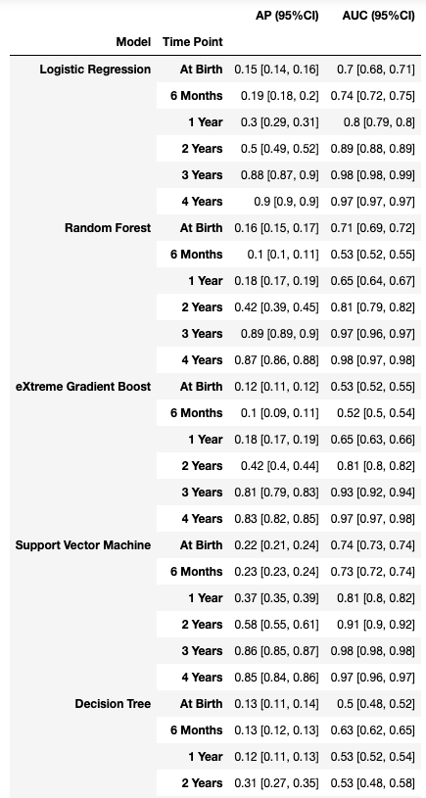
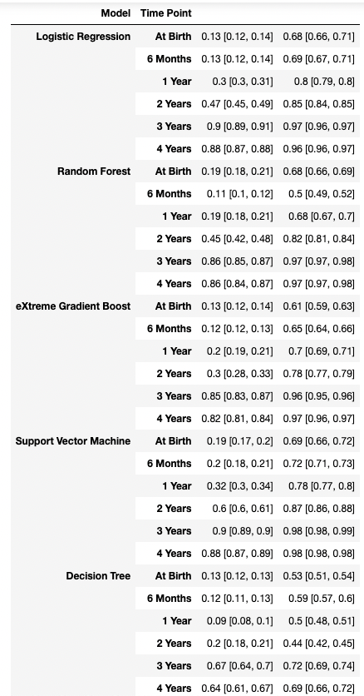
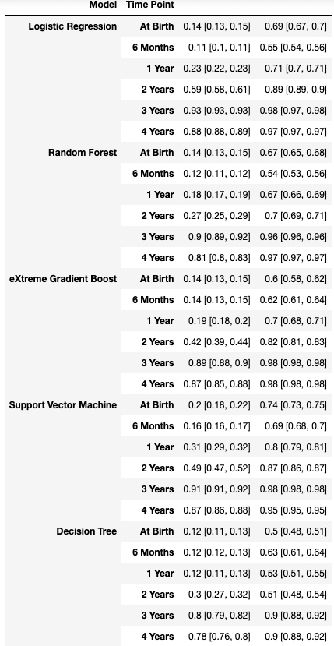
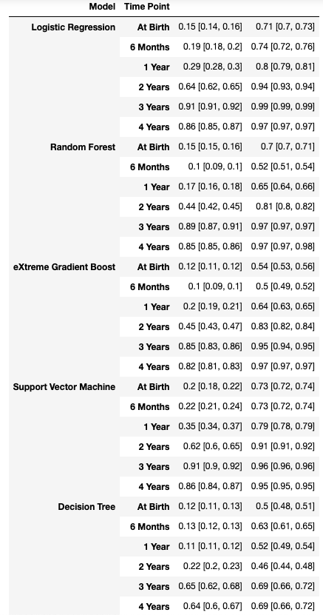
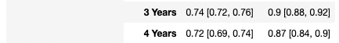
Results - ML performance
Input feature as previous one, - excluding parental food and inhalant # Unchanged
imputing_random_state=1000, # Changed,
indicator_threshold=9999, # as previous one
collinear_level=0.98, # Changed from 0.97 to 0.98
Input feature including both parental and child food inhalant, # changed
imputing_random_state=1000, # as left
indicator_threshold=9999, # as previous one
collinear_level=0.98, # as left
Input feature excluding both parental and child food, inhalant, # as fourth
imputing_random_state=20, # changed compared with fourth
indicator_threshold=9999, # as fourth
collinear_level=0.98, # as fourth
Input feature excluding both parental and child food, inhalant, # changed
imputing_random_state=1000, # as second
indicator_threshold=9999, # as previous one
collinear_level=0.98, # as second

Slide 5
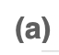
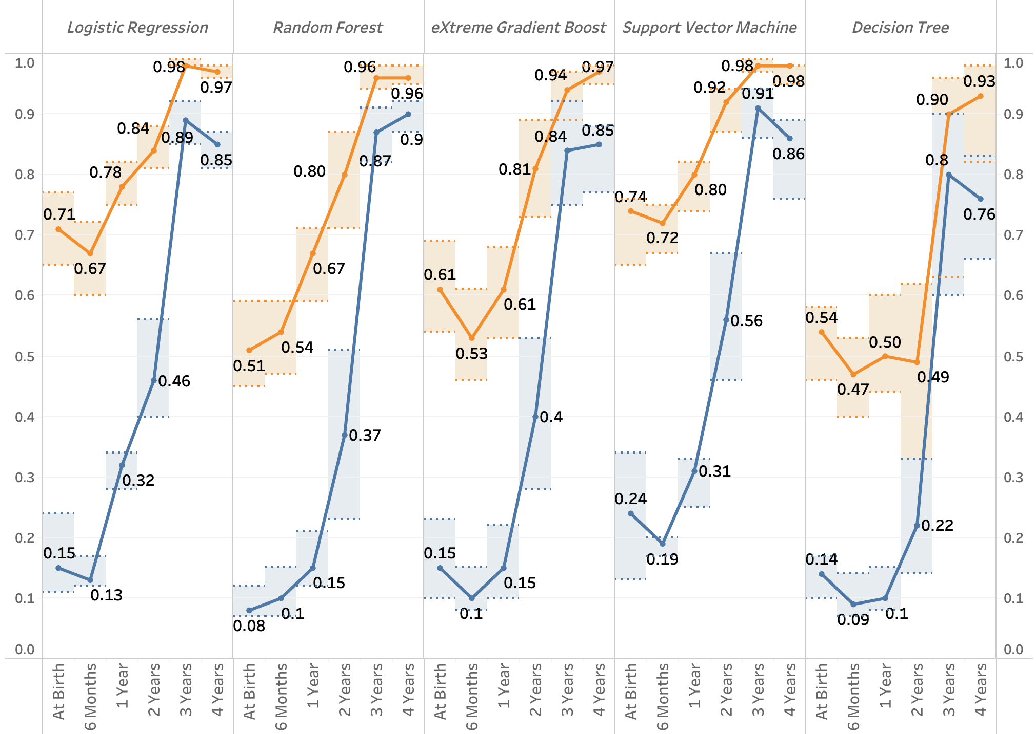
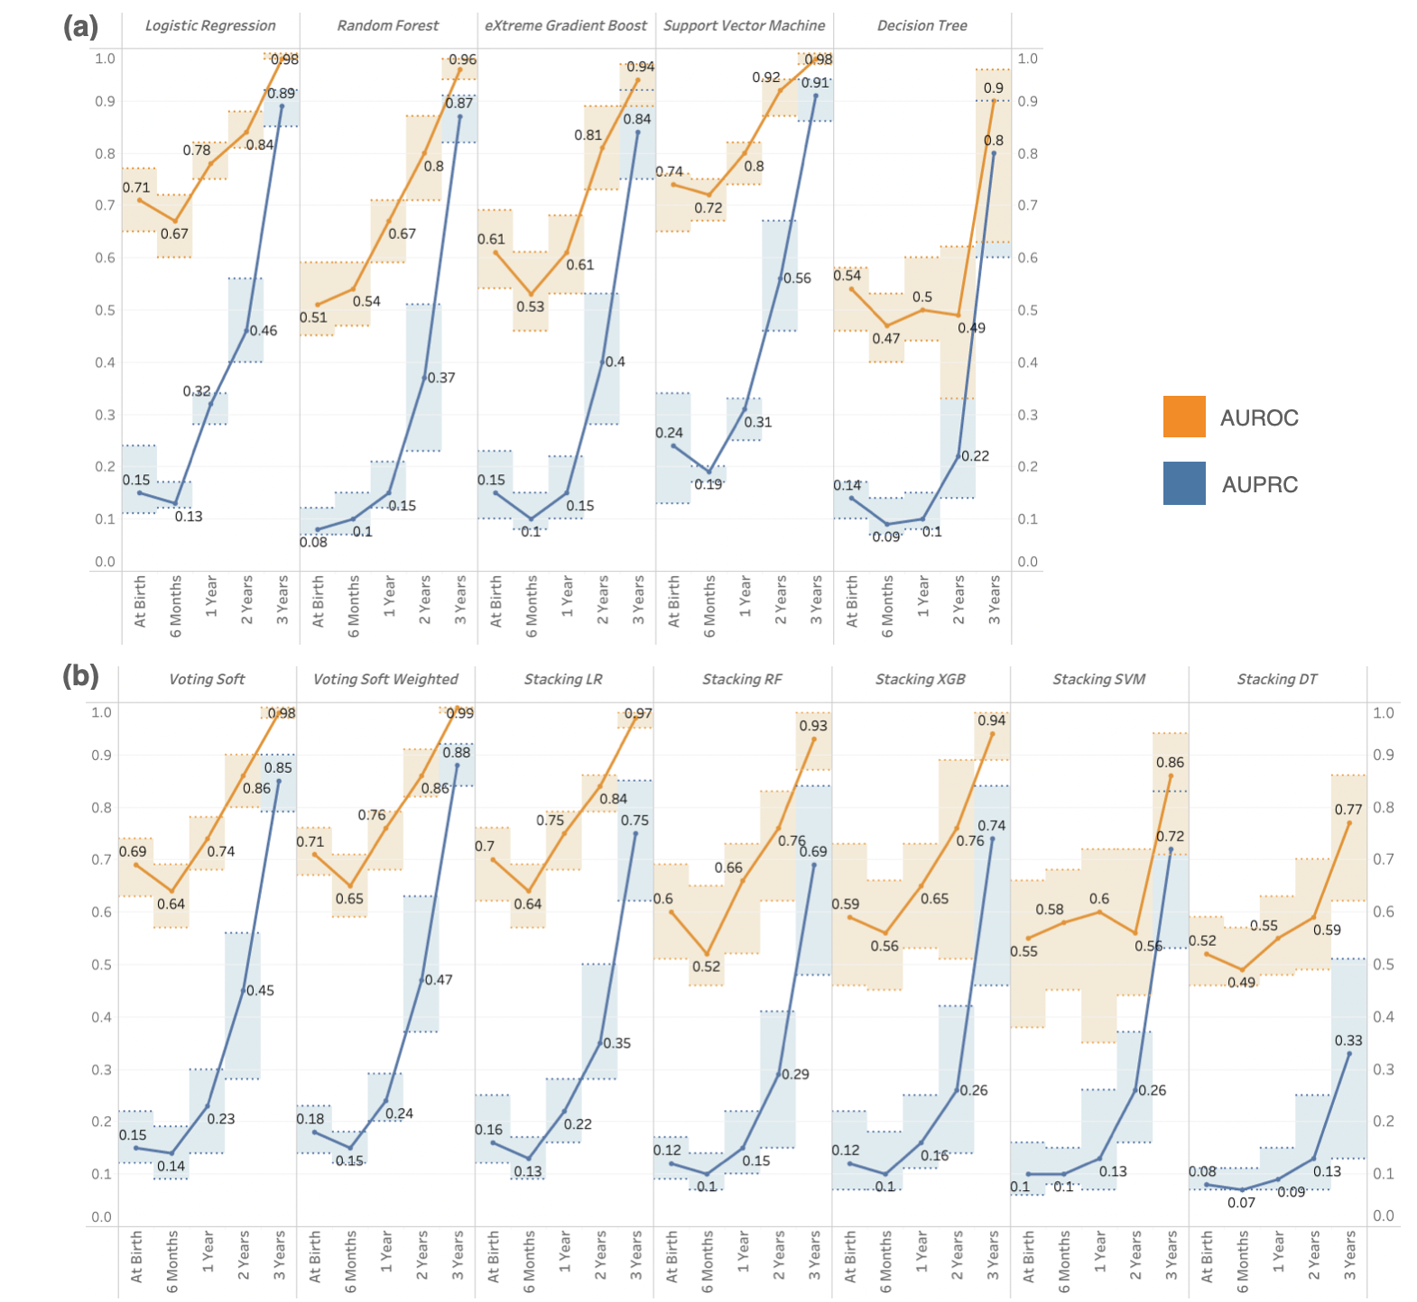
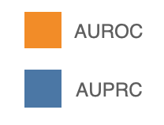
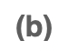
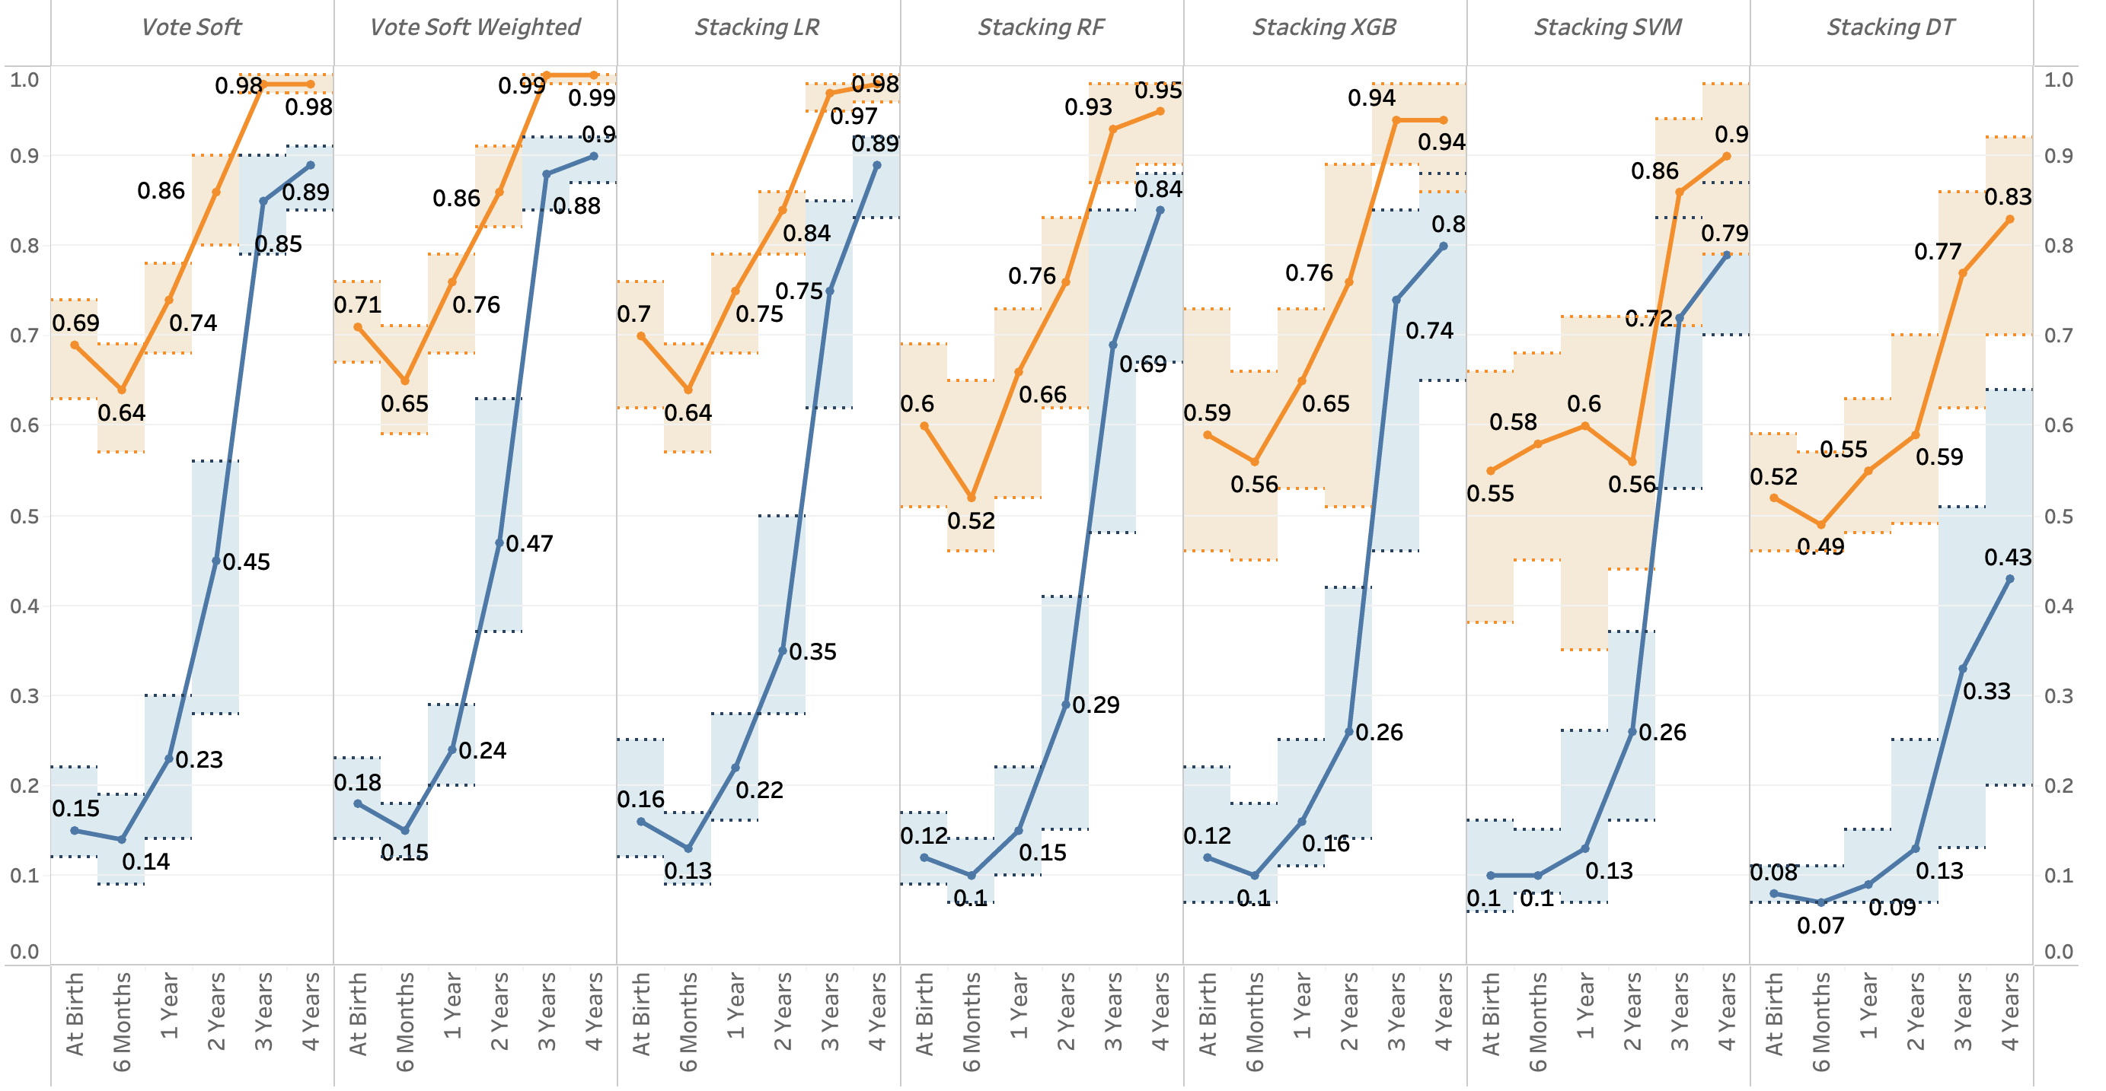
ML - Previous

Slide 6
Results - Feature Progression

Slide 7
Feature Progression - Previous

Slide 8
1) Multicollinearity -> Test
2) Missingness - > Imputation
3) Imputing Random State have impact!

Slide 9
“Cumulative_” Removed
“Child_Ethnicity_” Removed
“Time_Anti, Other_Condition, Implied Duration” Removed

Slide 11
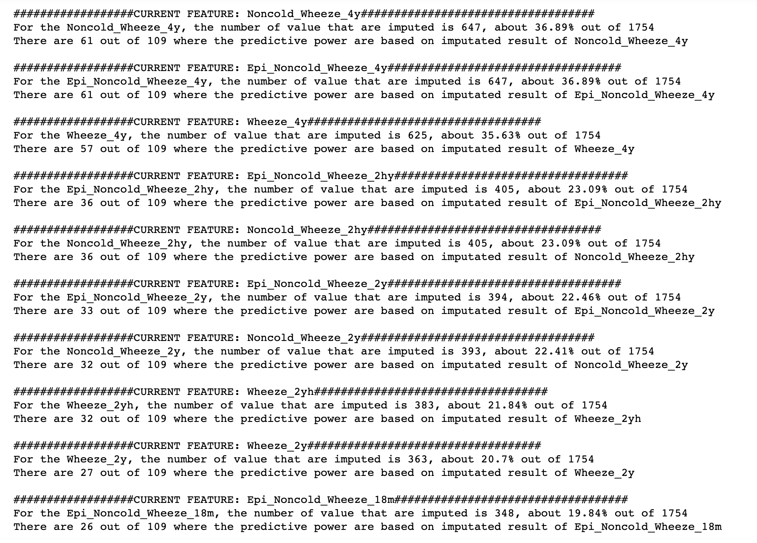
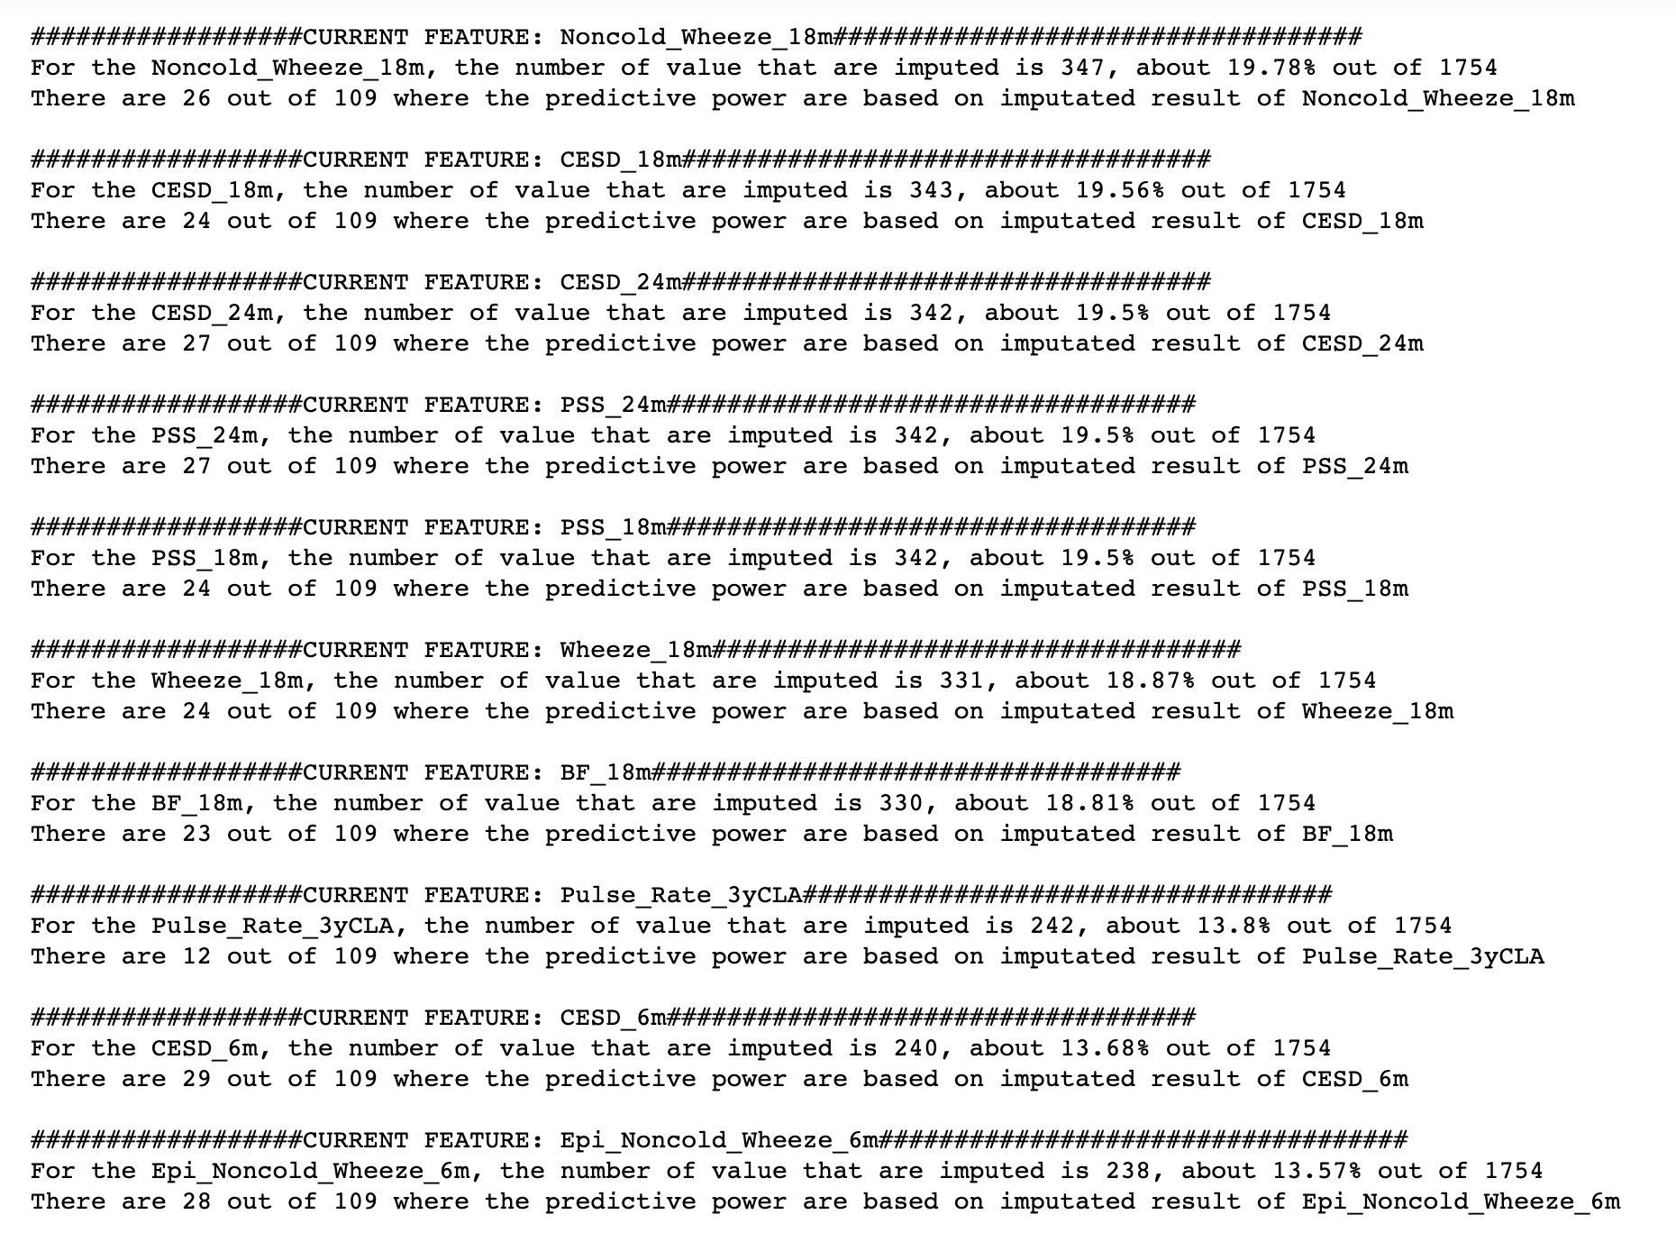

Slide 12
